Slide 1
HW2-冒險故事

Slide 2
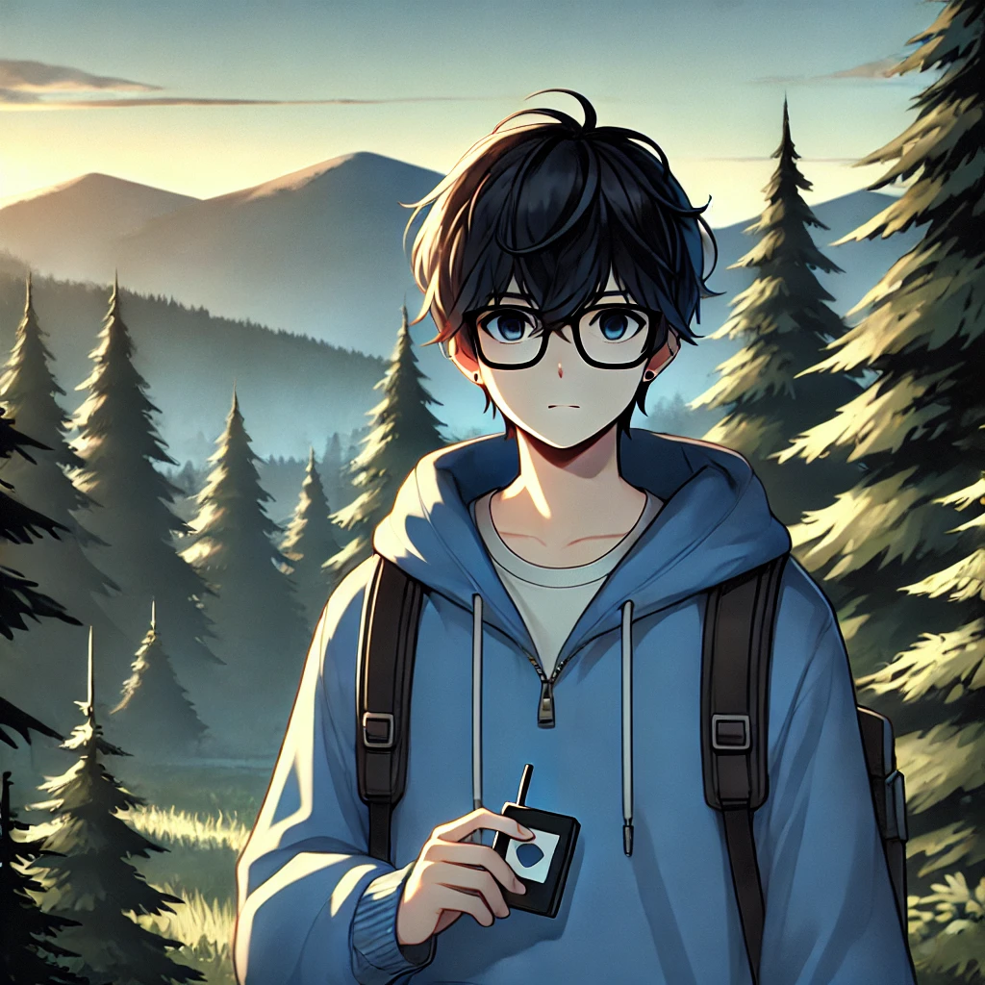

目標
Notes:
text to image
A young male character with short, black hair , wearing black square-framed glasses. The character is wearing a blue hoodie.The image is drawn in a soft and clean anime-style, with smooth lines and pastel colors.He stands at the edge of a vast forest. He holds a small map in one hand, looking determined as he gazes toward the distant mountains. The forest in front of him is thick and dark, with the sun setting in the background, casting long shadows over the trees.

Slide 3
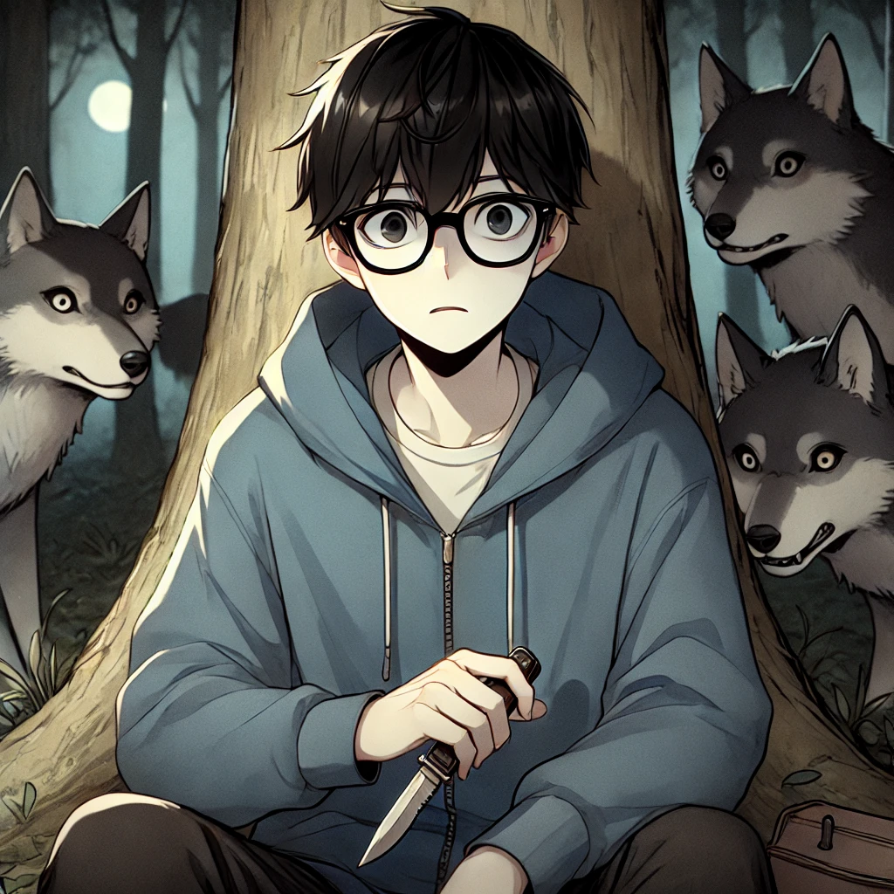
阻礙
Notes:
text to image
A young male character with short, black hair , wearing black square-framed glasses. The character is wearing a blue hoodie.The image is drawn in a soft and clean anime-style, with smooth lines and pastel colors.
He sits against a tree in the forest, looking exhausted and worried. His black square-framed glasses slightly crooked as he holds a small knife in one hand, watching a pack of wolves surrounding him from a distance. The forest is dark, and the shadows of the wolves are visible, their eyes glowing menacingly.

Slide 4
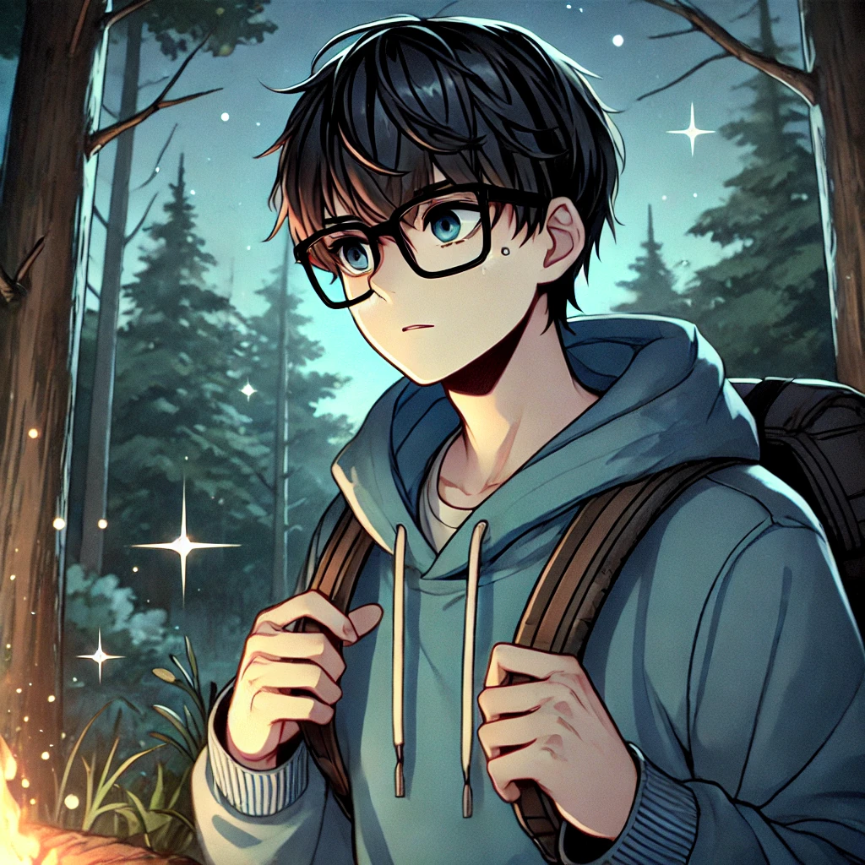
努力
Notes:
text to image
A young male character with short, black hair , wearing black square-framed glasses. The character is wearing a blue hoodie.The image is drawn in a soft and clean anime-style, with smooth lines and pastel colors.
He is navigating through the forest at night, following the stars for guidance. His expression is focused and determined as he uses the starlight to guide his way through the dense trees. A small campfire burns softly behind him, and his backpack is resting next to it.

Slide 5
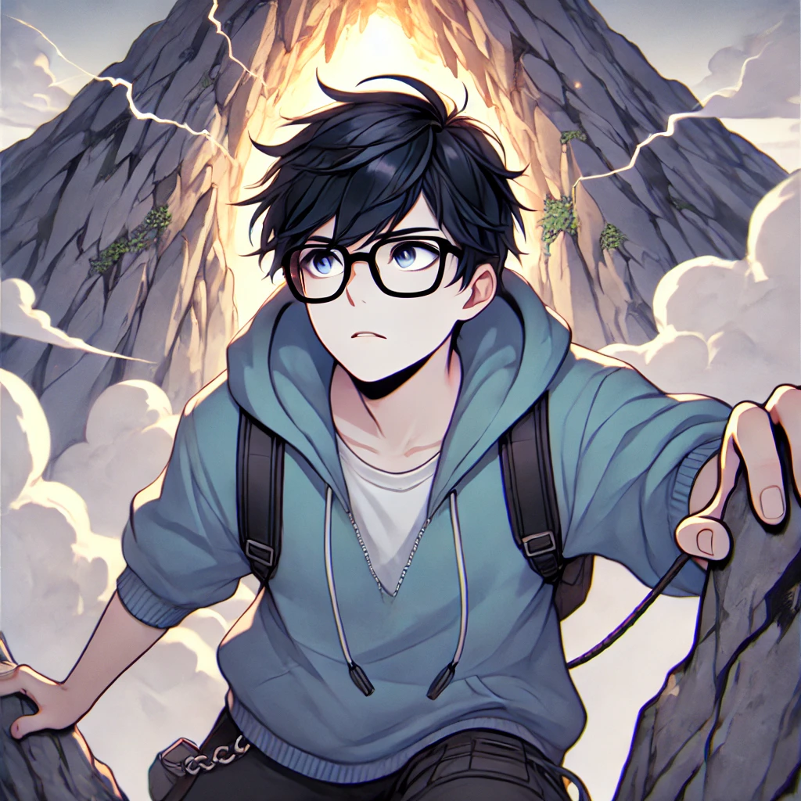
結果
Notes:
text to image
A young male character with short, black hair , wearing black square-framed glasses. The character is wearing a blue hoodie.The image is drawn in a soft and clean anime-style, with smooth lines and pastel colors.He climbs the side of a tall mountain. His face is filled with determination as he approaches a glowing cave at the mountain's peak. Dark clouds swirl around the mountain top, and lightning flashes in the distance, illuminating the jagged rocks underfoot.

Slide 6
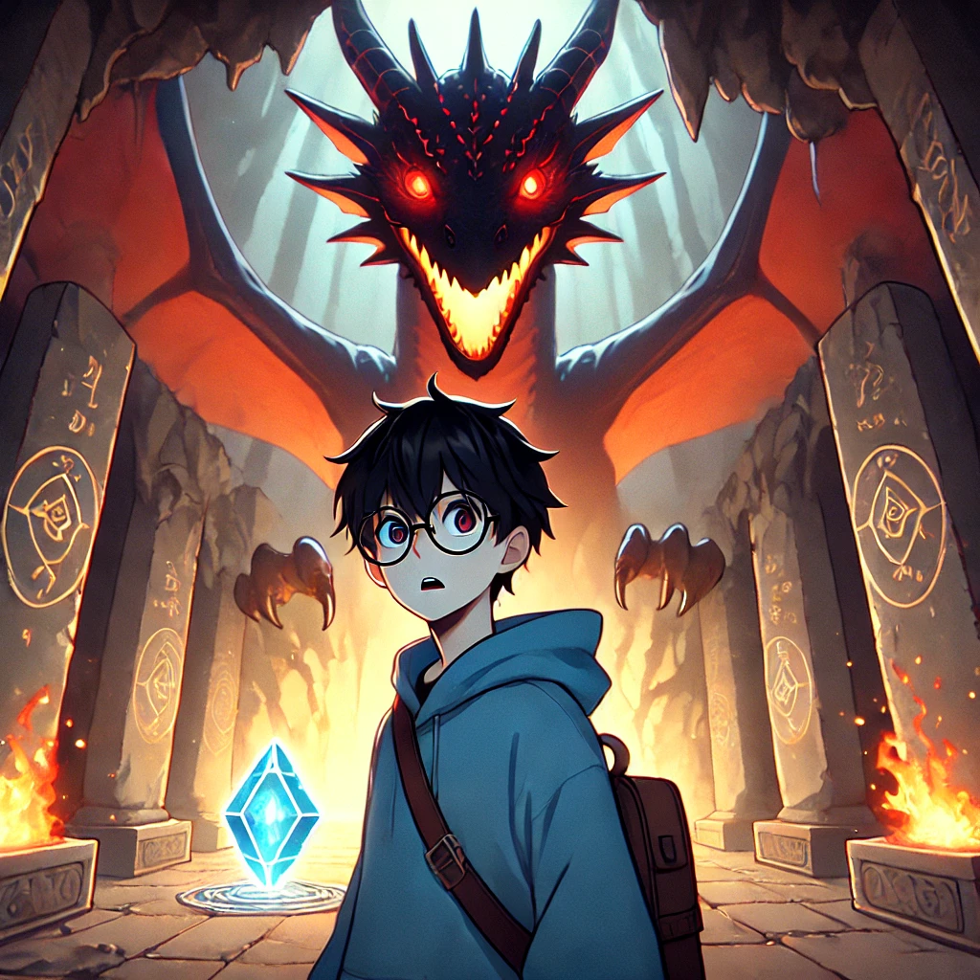
意外
Notes:
text to image
A young male character with short, black hair , wearing black square-framed glasses. The character is wearing a blue hoodie.The image is drawn in a soft and clean anime-style, with smooth lines and pastel colors.He is inside a massive cave. In front of him, a gigantic fire-breathing dragon appears, its red eyes glowing in the darkness. The boy is frozen in place, eyes wide with surprise, as the dragon guards a glowing, mystical gem. The cave walls are covered in ancient runes, and the ground shakes under the dragon's presence.

Slide 7
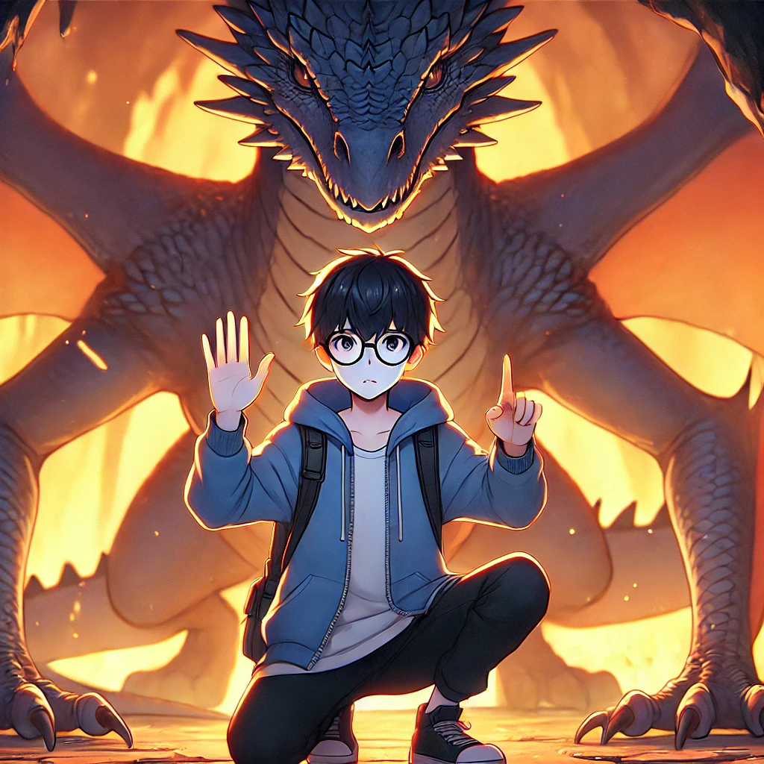
轉彎
Notes:
text to image
A young male character with short, black hair , wearing black square-framed glasses. The character is wearing a blue hoodie.The image is drawn in a soft and clean anime-style, with smooth lines and pastel colors.He kneels in front of the fire-breathing dragon. His hands are raised in a gesture of peace as he explains his purpose, hoping to convince the dragon to let him take the mystical gem. The dragon looms over him, watching him intently, its fiery breath lighting up the cave.

Slide 8
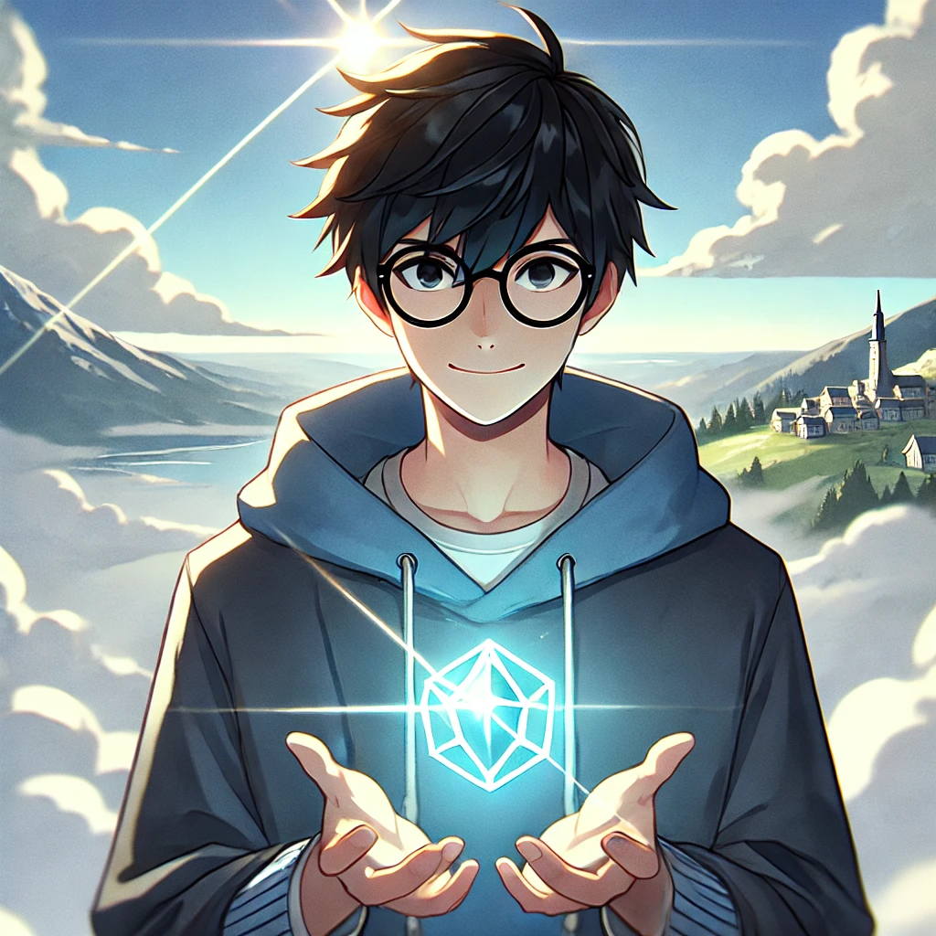
結局
Notes:
text to image
A young male character with short, black hair , wearing black square-framed glasses. The character is wearing a blue hoodie.The image is drawn in a soft and clean anime-style, with smooth lines and pastel colors.He is holding the mystical gem in his hands, stands triumphantly at the top of the mountain. Behind him, the clouds part, and beams of sunlight shine down, illuminating the village far below. His face shows a confident smile as he gazes at the horizon, ready to return as a hero.

